Slide 1
Twitters’ Thoughts on Airlines
By Team 10: EJ Peris, Eugenia Volscaia, Tymber, Jess Warner

Slide 2
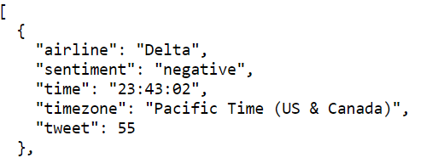
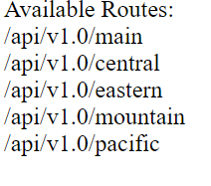
Data Source,Cleaning and the API:
The Data: Machine learning algorithm that would read tweets and determine user’s feelings towards airline. Data was then put into a SQLlite database. The data was then cleaned with a Sqlalchemy query
How did we clean it?
Timezone filters
Consumer confidence
Use of Substring for Time
What paths did we make?
Paths for each region.

Slide 3
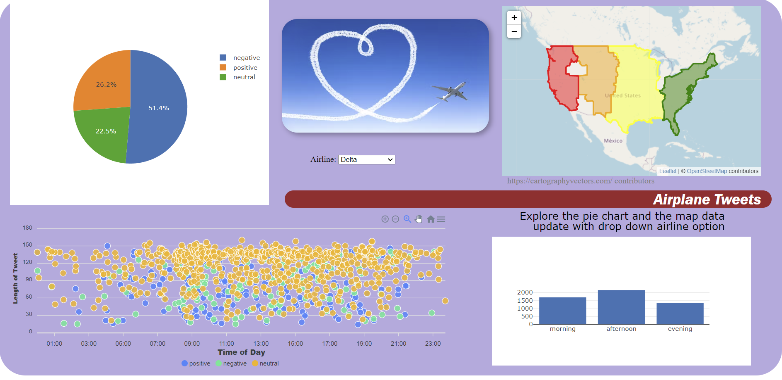
Basic Charts and Libraries Used:
Graphs Used:
We made the following graphs for our dashboard to assess consumer sentiment towards airlines and other consumer behavior:
Pie Chart that shows proportion of negative, positive, and neutral sentiment per airline
Map of how sentiment changed over time zones per airline
A scatter plot that shows how tweet length and sentiment changed overtime for all tweets
A bar chart that shows when most people tweeted at different airlines for all tweets.
Javascript Libraries Used:
D3
Plotly
Apex: For the time series categories.
Leaflet

Slide 4
Storylines:All but one airline have at least 50% of respondents feeling negatively towards the airline. Most tweets were coming from eastern and pacific time. Most of the tweets are coming from 11:00am-6:00pm. Neutral tend to be longer in length compared to positive and negative but no strong trend for time of day.

Slide 5
#Questions?

